Slide 1
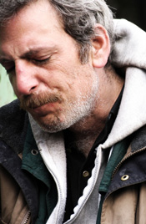
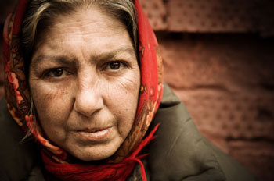
Neurological Disorders Lesson 5.5
When does abuse become addiction?

Slide 2
Do Now:
With a partner, brainstorms reasons why you think people start abusing drugs.

Slide 3
Why do people start abusing drugs?
Feel pleasure
Improving self-image
Peer pressure
Self-medicate
Relieve stress
Curiosity

Slide 4
When does abuse become addiction?
No Use
Drug Abuse
Drug Addiction
Drug Abuse
The overuse of a drug by an individual.
Drug Addiction
The continued compulsive use of drugs in spite of adverse health or social consequences.

Slide 5
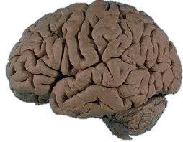
Addiction Card Game Risk: The Game of Life Domination

Slide 6
Risk: The Game of Life Domination
Rules of the Game
Two players per game. Each player starts with a score of 30 points.
Shuffle card deck. Place deck face down between the two players.
Players take turns drawing a single card from the deck. Follow directions on card to adjust the player’s point total.
When a COCAINE card is drawn, the player with the lowest point total is most likely to become addicted and LOSES the game.

Slide 7
Who Got Addicted? Why?
Protective Factors and Risk Factors
Two main categories
Social and Psychological
Genetic and Biological

Slide 8
Social and Psychological Factors
Protective Factors
Risk Factors
You are in good mental health.
Your reward pathway is highly active, and you feel rewarded and happy about your life.
You have healthy coping mechanisms for stress.
Your friends do not use drugs.
You are currently not addicted to nicotine.
You have recently been diagnosed with depression.
Your reward pathway is underactive, and you feel dissatisfied and unhappy about your life.
You lack healthy coping mechanisms for stress.
You are frequently surrounded by friends who use drugs and feel pressure to use drugs to fit in.
You are currently addicted to nicotine.

Slide 9
Genetic and Biological Factors
You have a family history of addiction.
Protective Factor or Risk Factor???

Slide 10
Genetic and Biological Factors
You have a family history of addiction.
Risk Factor
You have no family history of addiction.
Protective Factor

Slide 11
Genetic and Biological Factors
You naturally release more dopamine in the synapse than the average person.
Protective Factor or Risk Factor???

Slide 12
Genetic and Biological Factors
You naturally release more dopamine in the synapse than the average person.
Risk Factor

Slide 13
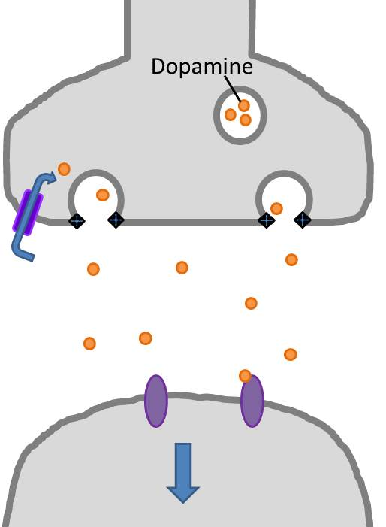
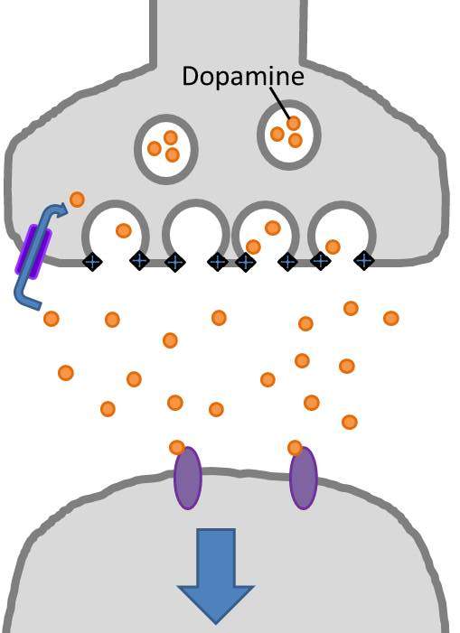
Protective Factor
Risk Factor
Release Less Dopamine
Release More Dopamine
Cocaine
Cocaine

Slide 14
Genetic and Biological Factors
You have more dopamine receptors than the average person.
Protective Factor or Risk Factor???

Slide 15
Genetic and Biological Factors
You have more dopamine receptors than the average person.
Risk Factor

Slide 16
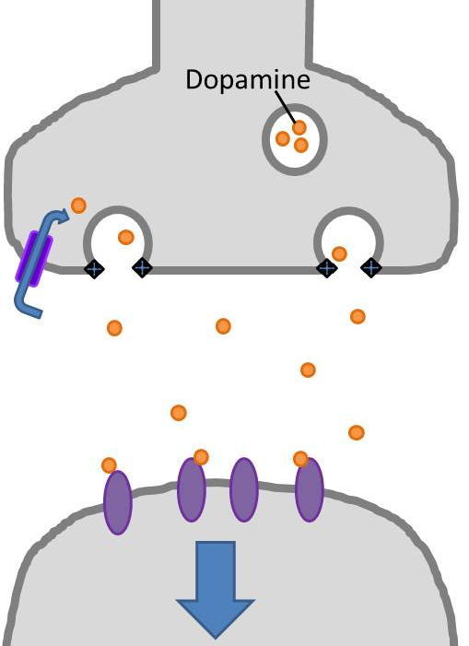
Protective Factor
Risk Factor
Normal Dopamine Receptors
More Dopamine Receptors
Cocaine
Cocaine
Notes:
Test

Slide 17
Genetic and Biological Factors
You are taking a prescription drug that blocks dopamine receptors.
Protective Factor or Risk Factor???

Slide 18
Genetic and Biological Factors
You are taking a prescription drug that blocks dopamine receptors.
Protective Factor

Slide 19
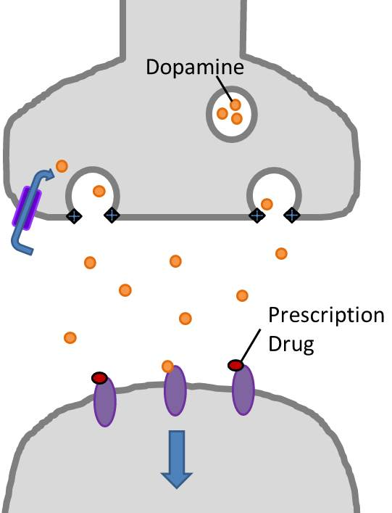
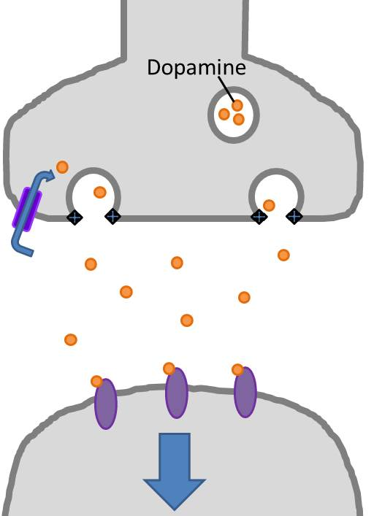
Protective Factor
Risk Factor
Prescription Drug Blocking Receptors
No Prescription Drug
Cocaine
Cocaine
Notes:
Test

Slide 20
Genetic and Biological Factors
You are taking a drug that blocks dopamine transporters in reward pathway.
Protective Factor or Risk Factor???

Slide 21
Genetic and Biological Factors
You are taking a drug that blocks dopamine transporters in reward pathway.
Protective Factor

Slide 22
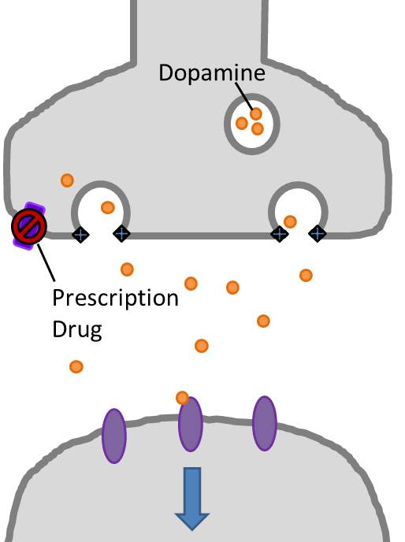
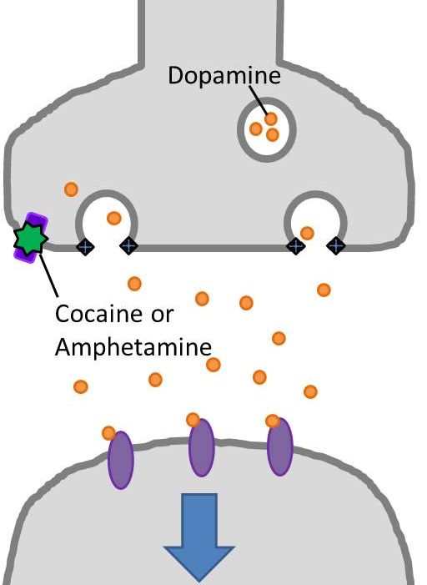
Protective Factor
Risk Factor
Prescription Drug Blocking Transporters
No Prescription Drug
Notes:
Test

Slide 23
Genetic and Biological Factors
Protective Factors
Risk Factors
No family history of addiction.
Taking a drug that blocks dopamine receptors.
Taking a drug that blocks dopamine transporters in reward pathway.
Family history of addiction.
You naturally release more dopamine in the synapse than the average person.
You have more dopamine receptors than the average person.

Slide 24
Drug Use by Soldiers in Vietnam

